Slide 1


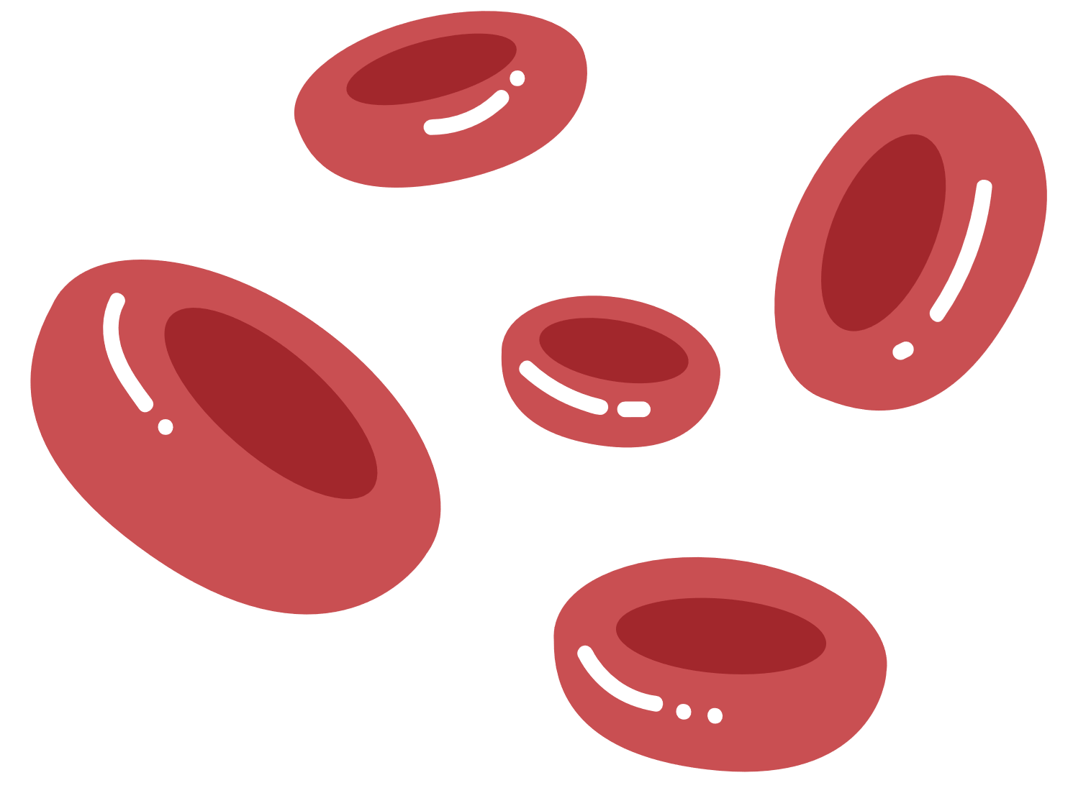

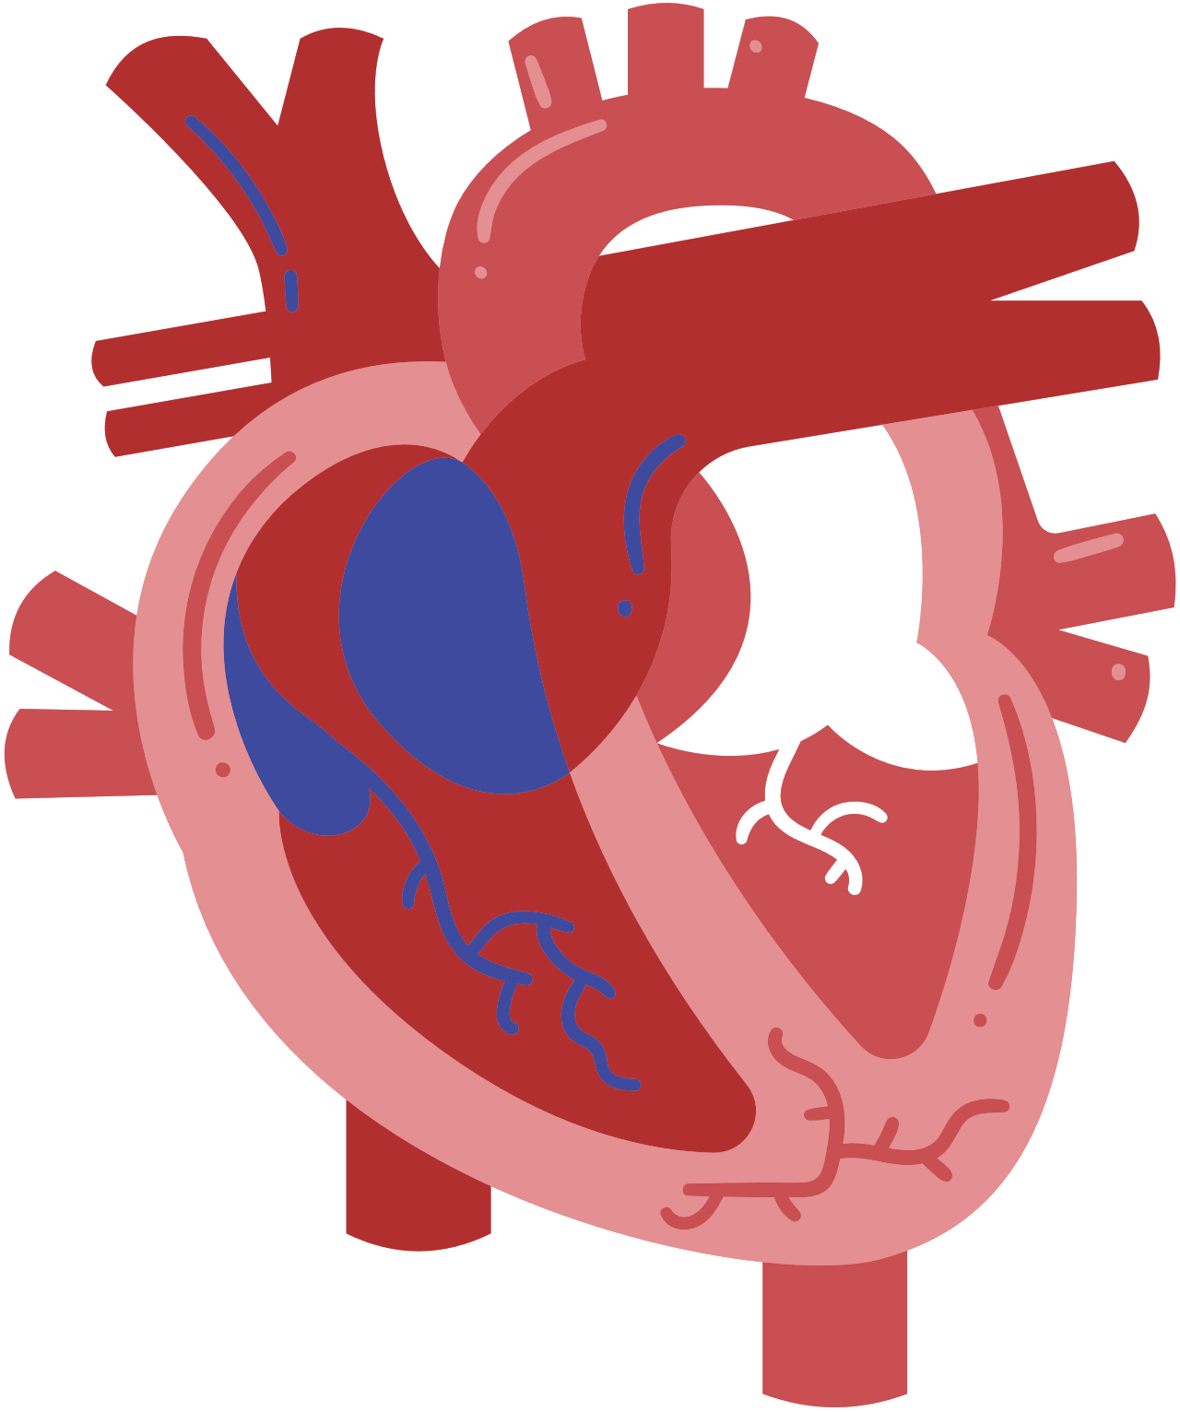
Blood
Link
Linking Donors. Saving Lives.

Slide 2
Team Details
Team Lead
Anubhav Singh Rathore
23BLC1280
anubhav.singh2023@vitstudent.ac.in
ROHITH KODALI
23BLC1016
kodalil.rohith2023@vitstudent.ac.in
B Bhavana Deepthi
23BRS1170
bhavanadeepthi.b2023@vitstudent.ac.in
Varsha Singh
22BCE9133
varsha.22bce9133@vitapstudent.ac.in
Ankit Kumar
23BCE10519
ankit.23bce10519@vitbhopal.ac.in

Slide 3
Team Contribution
Anubhav Singh Rathore –> Dashboard , Donate blood, Sign-up/Login
Rohith Kodali –> Find Blood
Bhavana Deepthi–> Profile
Ankit Kumar -> Profile
Varsha Singh-> Donate blood

Slide 4

Problem Statement
During medical emergencies, patients and their families often struggle to find compatible blood donors or nearby blood banks with required blood types, especially in smaller towns and at odd hours.”
Lack of accessible donor databases
No centralized, live information on blood availability
Delay in communication between donors, hospitals, and recipients

Slide 5


Our Solution – The Blood Link App
An intuitive mobile app that:
Connects blood donors and acceptors in real-time
Shows nearby blood banks with current blood stock
Simplifies and encourages the process of blood donation

Slide 6
Concepts Used
Firebase Firestore Integration – for real-time database operations.
User Authentication (Firebase Auth) – for secure login and signup.
FusedLocationProviderClient – to get the user’s current GPS location.
Google Places API (via Retrofit) – to fetch nearby hospitals and blood banks.
Retrofit API Integration – for efficient network calls and JSON parsing.
RecyclerView with Custom Adapter – to display dynamic lists like donors and hospitals.

Slide 7
Thank You!

